Slide 1
Mbed WAVPlayer
Alex Melendez
Goucher College 2016
Senior Project

Slide 2
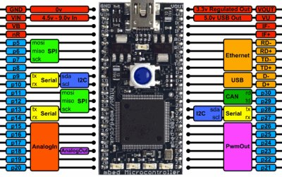
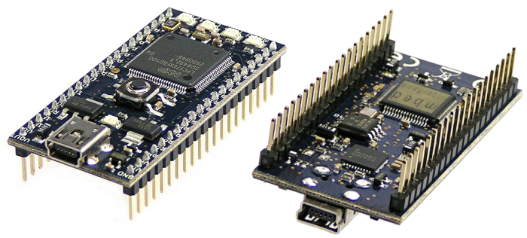
Mbed lpc1768

Slide 3
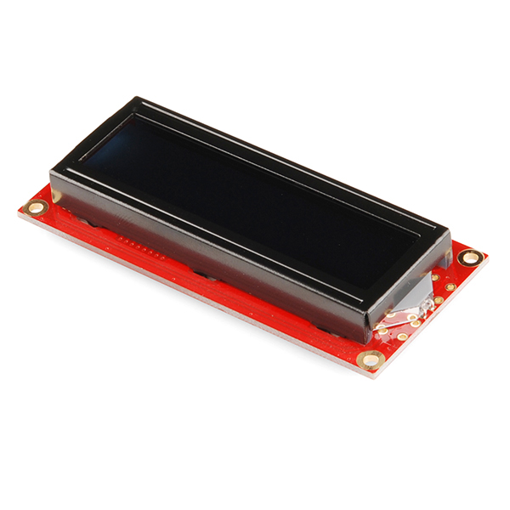
ST7066/HD44780 Text LCD

Slide 4
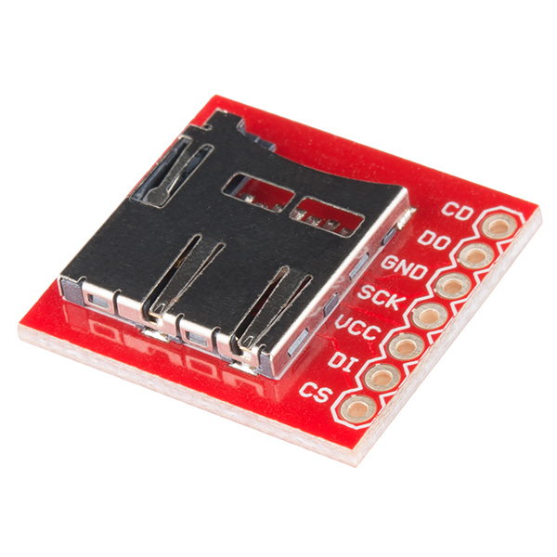
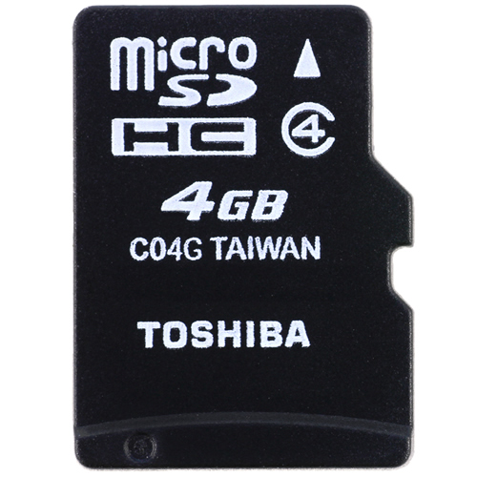
microSD Transflash Breakout & 4GB microSD card

Slide 5
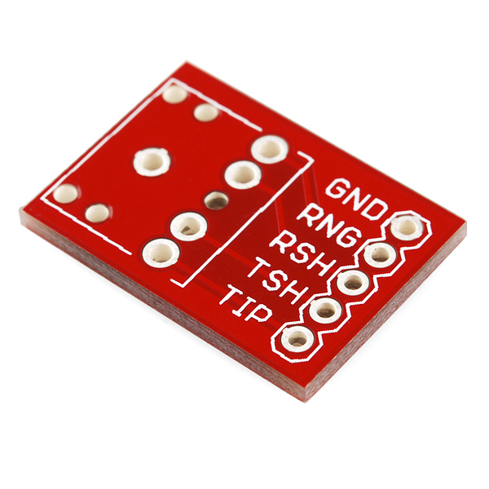
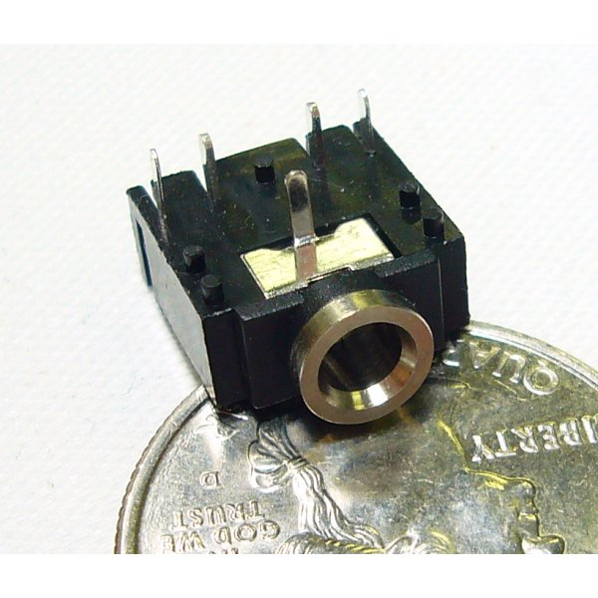
Audio Jack Breakout

Slide 6
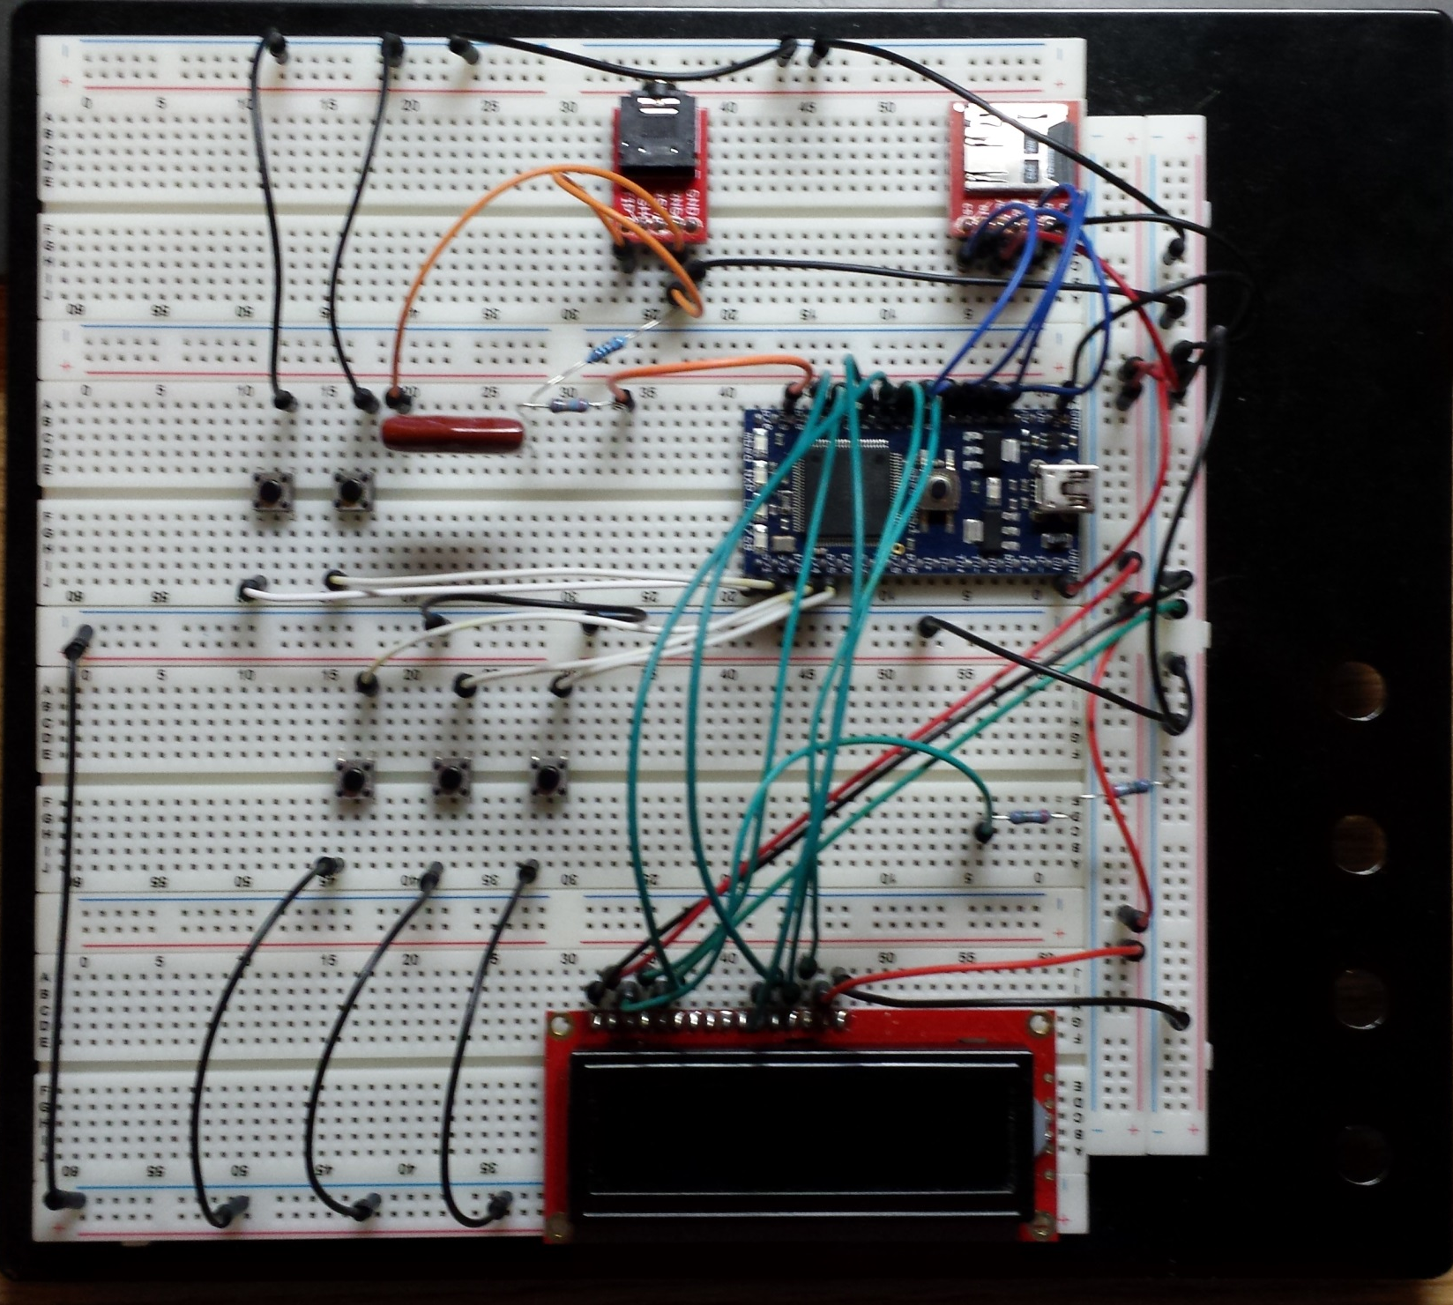

Slide 7
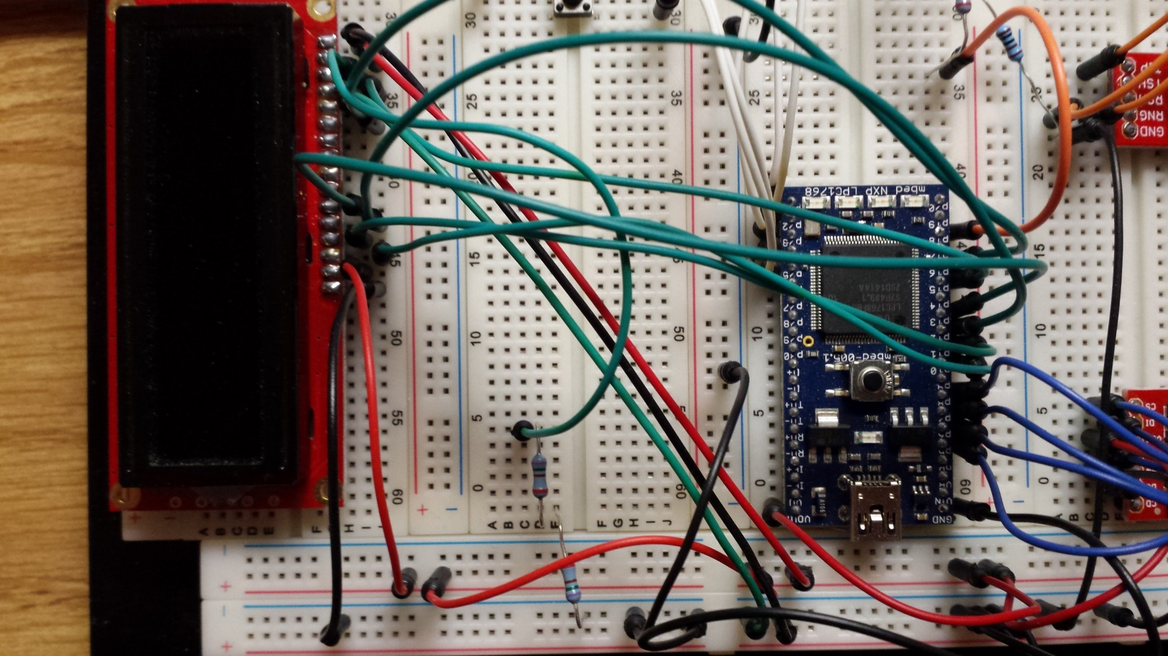
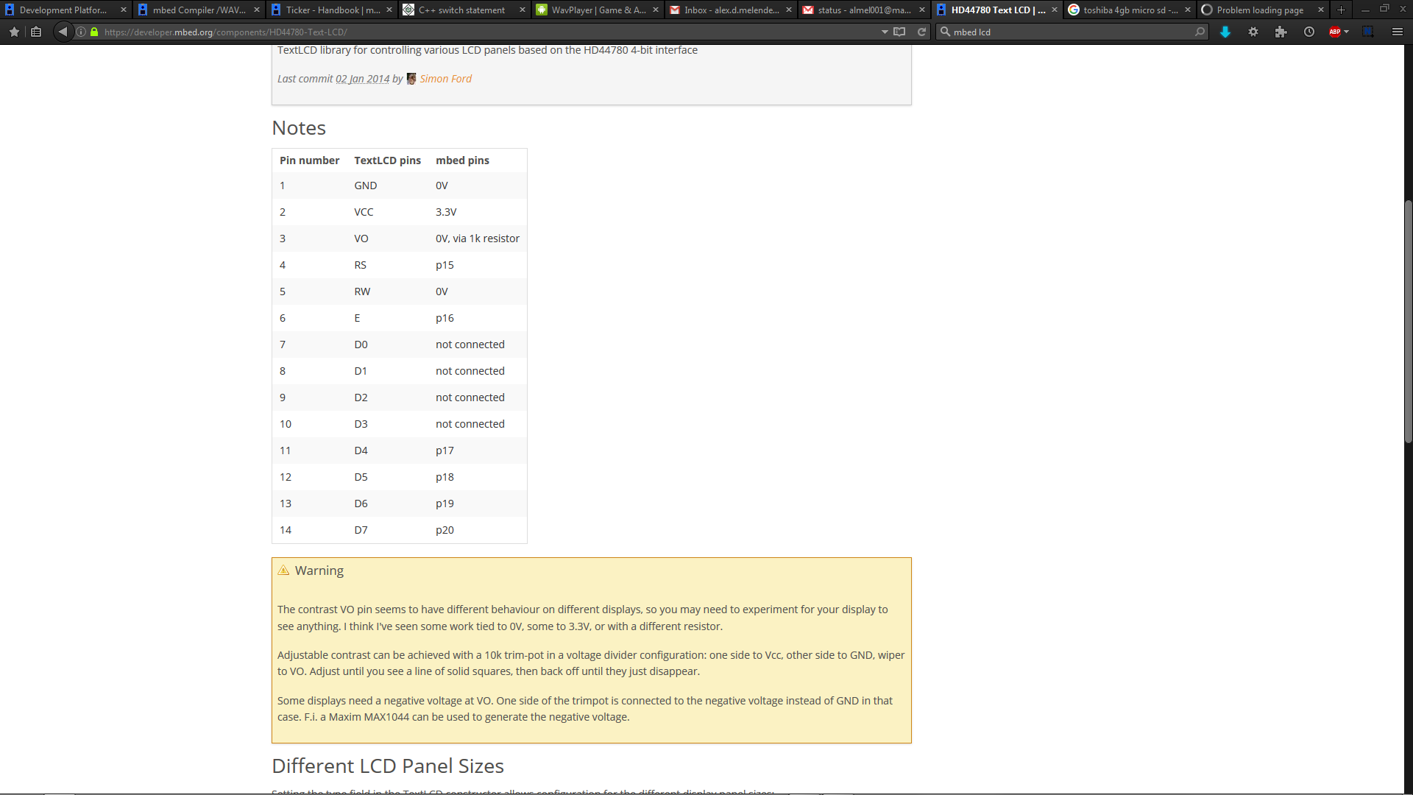

Slide 8
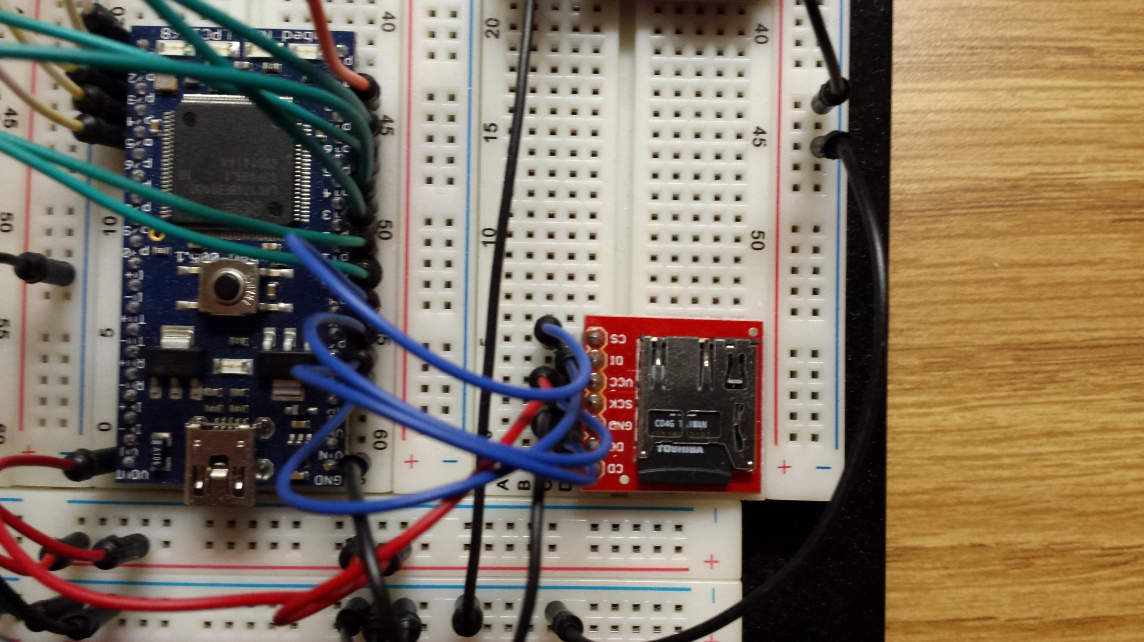
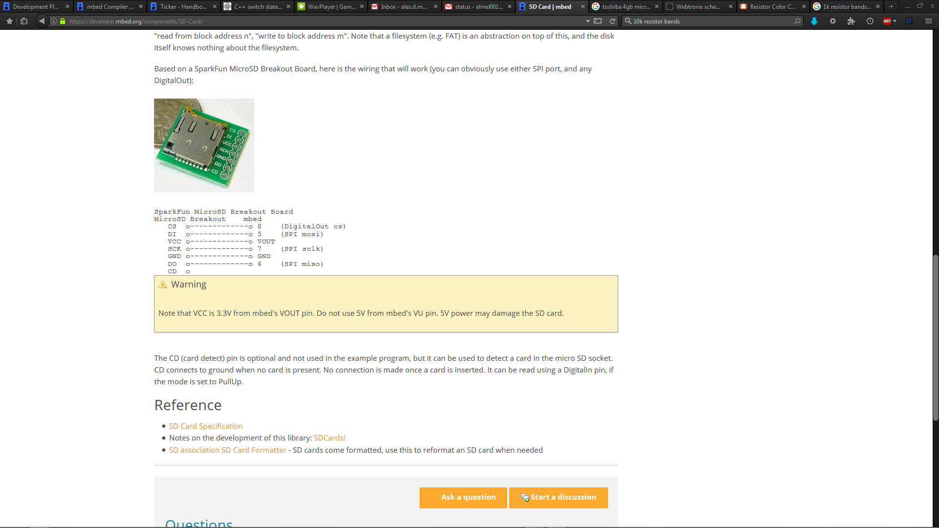

Slide 9
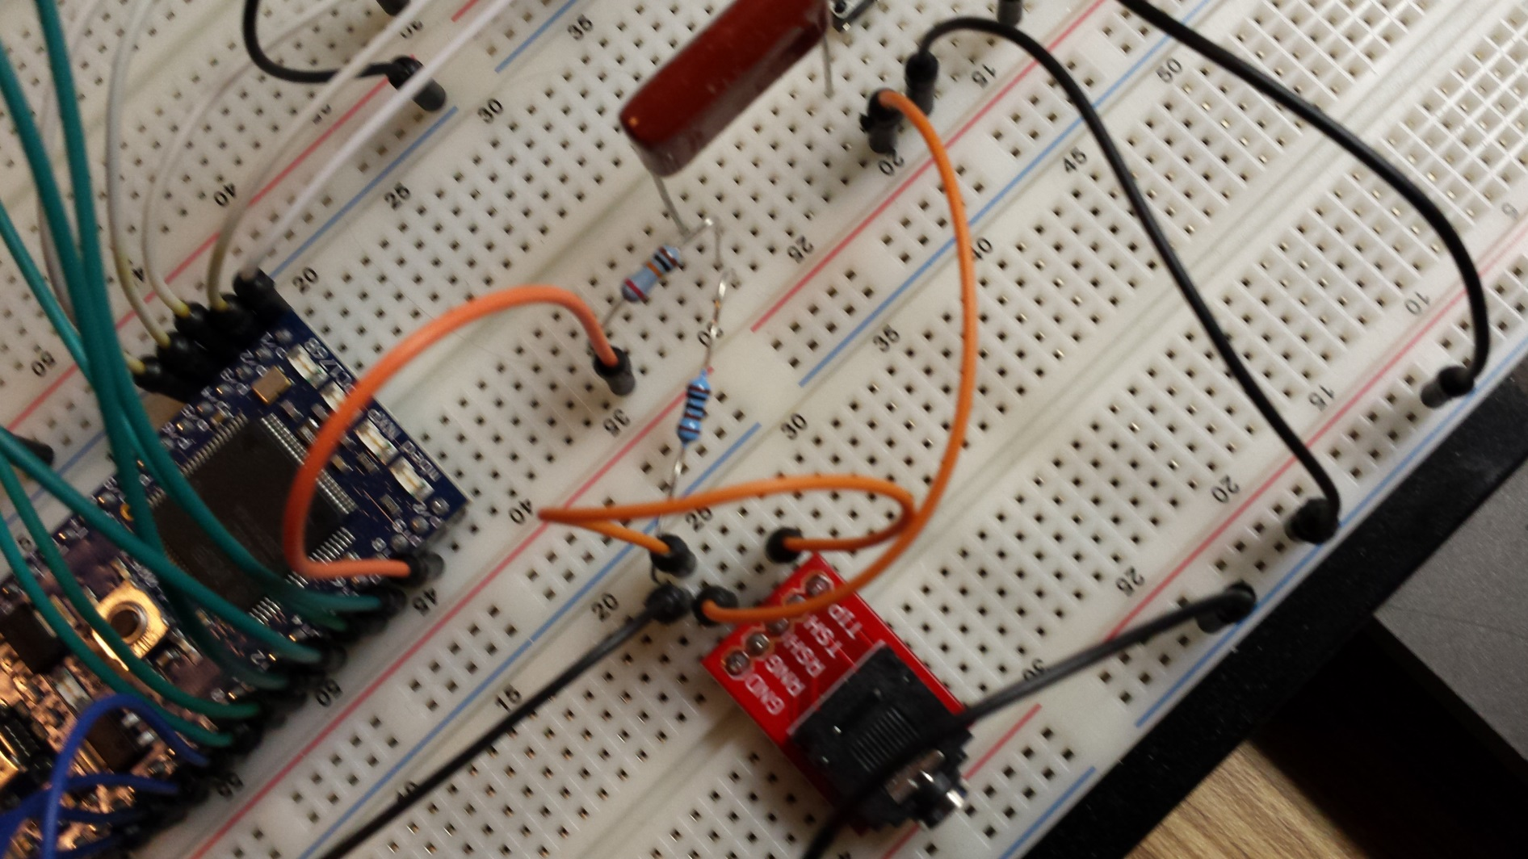
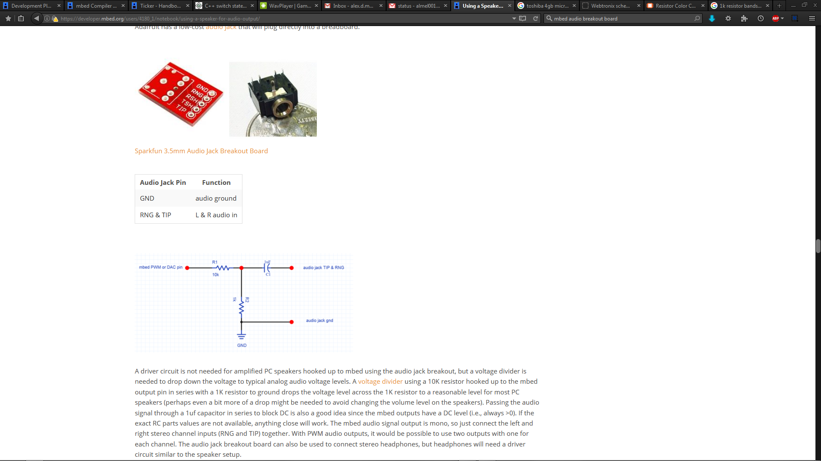

Slide 10
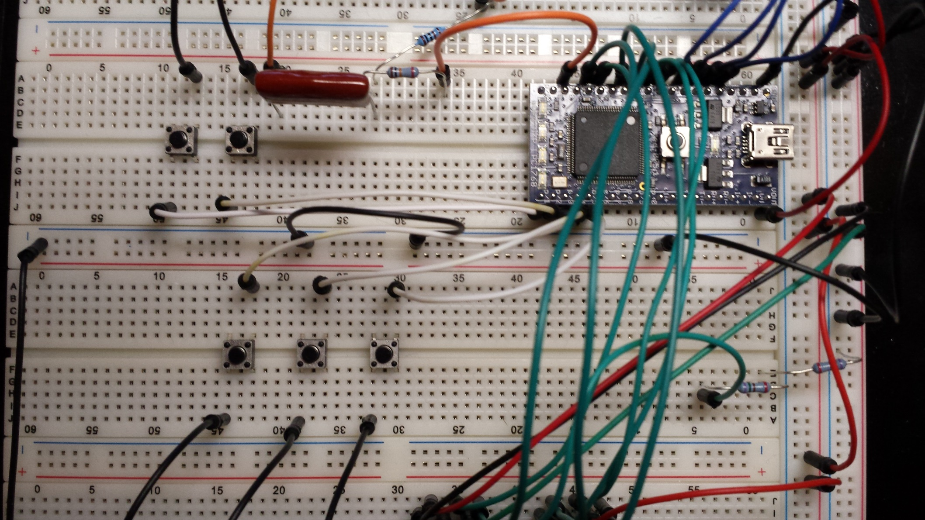

Slide 11
Initial Libraries
Mbed; Mbed Official
PinDetect; Andy Kirkham
SDFileSystem; Mbed Official
TextLCD; Simon Ford
Wave_player; Steve Ravet

Slide 12
Playing Songs
Iterate through vector of filenames (iterator object)
void read_file_names(char *dir)
{
DIR *dp;
struct dirent *dirp;
dp = opendir(dir);
while((dirp = readdir(dp)) != NULL)
{
filenames.push_back(string(dirp->d_name));
}
}

Slide 13
Play/Pause
Global bool playing
Pushbutton interrupt (PinDetect)
while(!playing)
{
wave_DAC->write_u16(-100);
}
Still not completely silent, major headache

Slide 14
LCD
Displays current song title; cuts out .wav
Updates when song is changed
Displays “Paused” when playing == false

Slide 15
Skip Songs
Global bool stop
Pushbutton interrupt (PinDetect)
If (stop) { break; }
Increment/decrement iterator

Slide 16
Volume
Global variable volume
Edited one line in play function: DAC_fifo[DAC_wptr]=((volume)*dac_data)>>4;
Volume divided into 16 levels
Pushbutton interrupt (PinDetect)

Slide 17
LEDs
LEDs 1-4 on Mbed
Used 2 Tickers: volLights and pauseLights
volLights called every 0.01s, pauseLights called every 1s
Lights indicate relative volume

